Slide 1
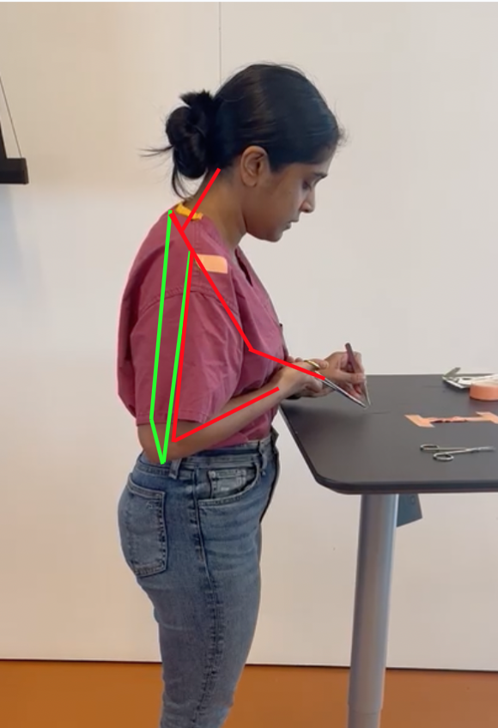
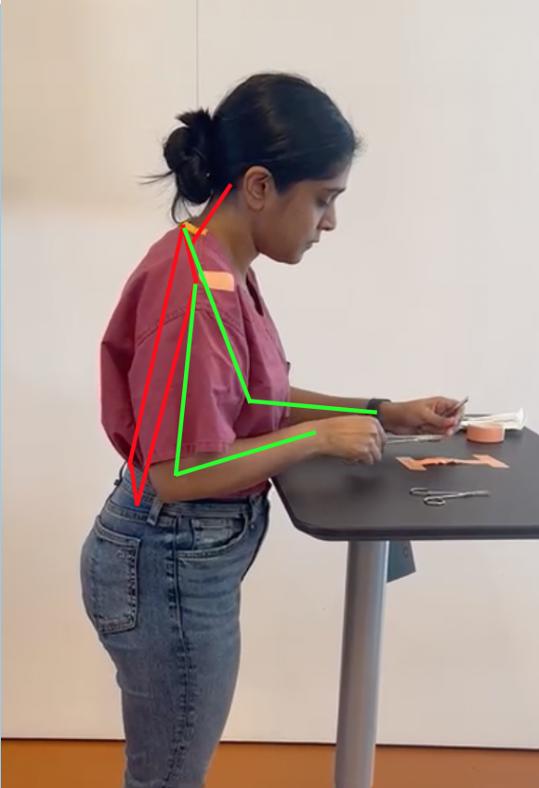
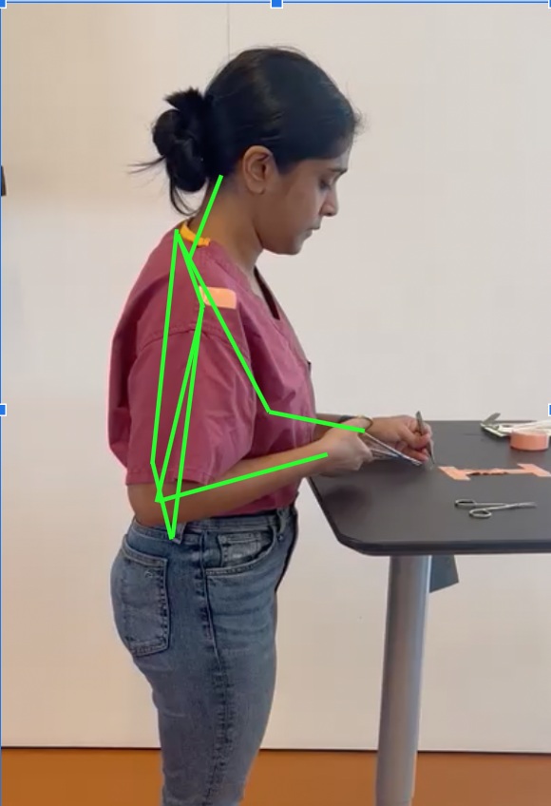

inSim
[insert logo]
Surgical ergonomic training to promote career longevity

Slide 2
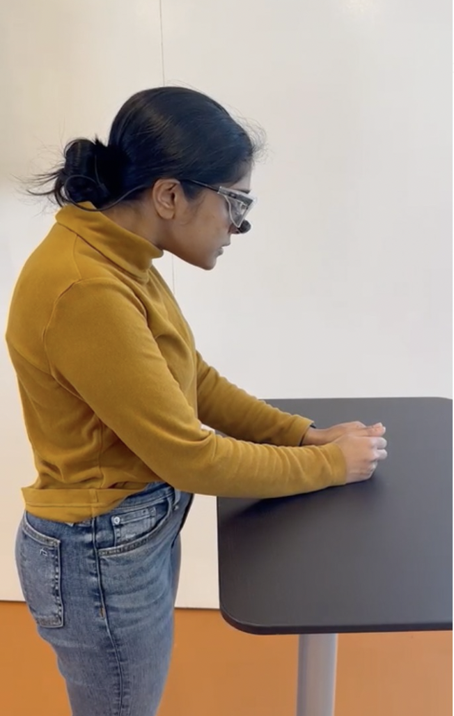
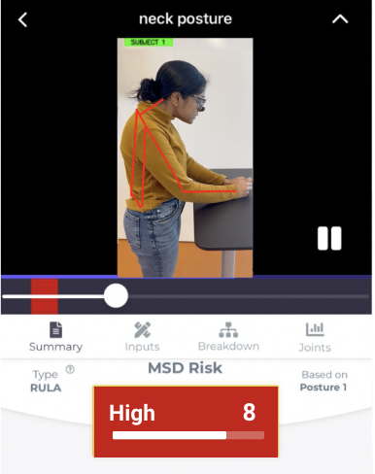
Surgeons have the
Highest Rate of work-related Musculoskeletal Disorders
Chronic MSK conditions
MSD-Sick leave & sabbaticals that cost hospitals >$15M a year!
Early retirement
RESIDENT
SURGEON
A way to address lack of ergonomic surgical training for surgical residents to promote career longevity
Notes:
Surgeons report MSD. They develop bad posture during training and keep bad posture leading loss.
way to address lack of ergonomic training

Slide 3
Computer Vision Powered Posture analysis
Utilizing Simulation Centers
Using Industry Standard metrics: RULA and REBA
Using Industry standard practices from ACS
Notes:
Using computer vision for accurate risk and strain assessment
Guided ergonomic training w/ real time feedback
Personalized and actionable recovery steps

Slide 4
[insert logo]
RESIDENT
SURGEON

Slide 5
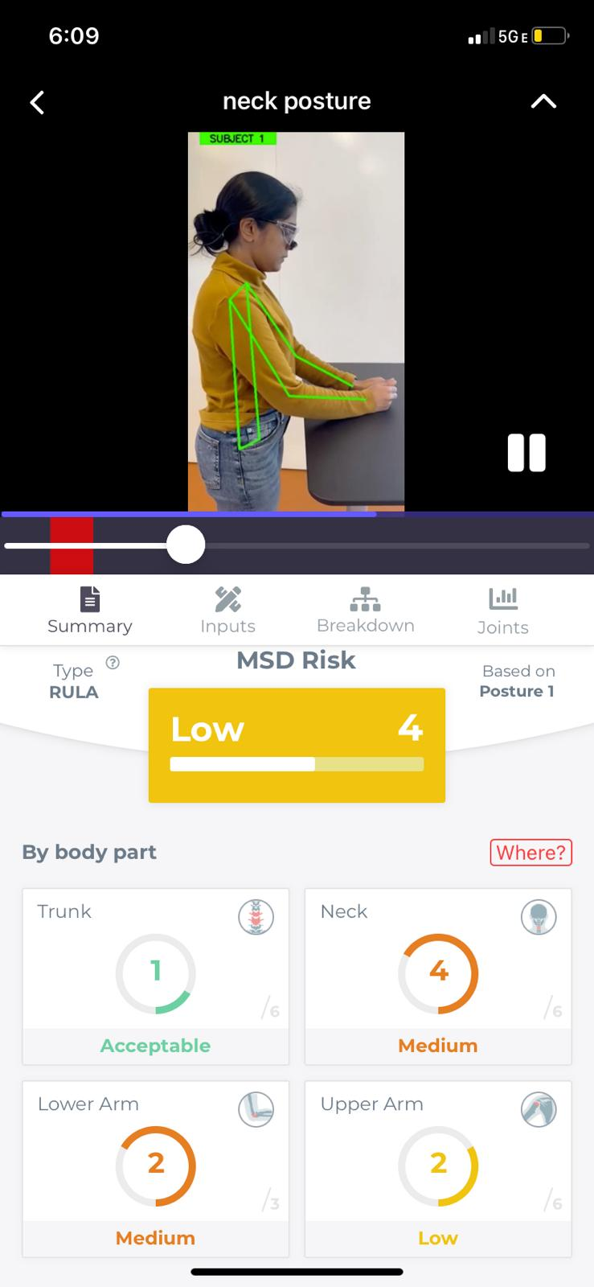
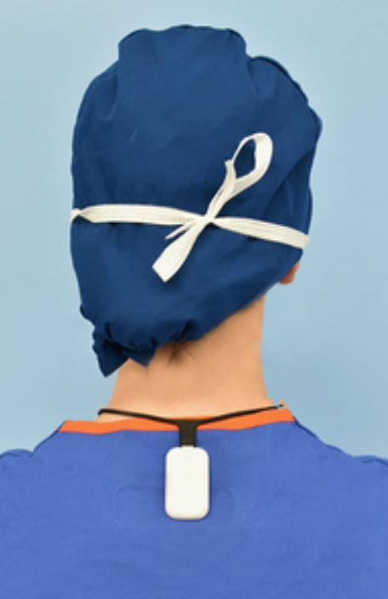



Gap Analysis
Upright Go
Our Design
Non-disruptive
Targeted Training
Surgeon-Specific
Data Metric for Hospitals

Slide 6
Total Addressable Market (Posture Correction Market):
$350 Million USD
Market Analysis (USA)
Target Market: Surgical Education and Training
Target Population: Medical Students, Residents
Business Model: Subscription Based
Price/Product: $350
Penetration Rate: 10%
Serviceable Addressable Market (Posture Correction for Healthcare workers):
$6 M
Serviceable Obtainable Market (10% Penetration Rate):
$600 Thousand
References: https://www.grandviewresearch.com/industry-analysis/posture-correction-market-report
SAM estimated 1.8% adults are surgeons (https://www.statista.com/statistics/209424/us-number-of-active-physicians-by-specialty-area/), approximately 45% Posture market = Adults (from above report)
Notes:
Update for US model

Slide 7
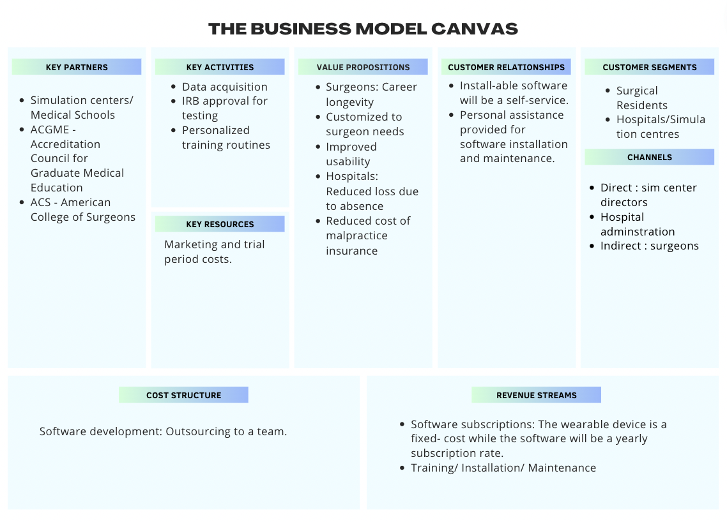
Business Model

Slide 8

Discovery Plan
# | Name | Company | Role
1 | Dr Meghal Shah | CUIMC | 3rd Year surgical Resident
2 | Dr Tejas Sathe | CUIMC | 3rd year surgical resident
3 | Dr Alexander P Kossar | CUIMC | 5th year Surgical Resident
4 | Dr. Susan Hallbeck | Mayo Clinic | Engineer working on surgical ergonomics
5 | Erin M Duggin | CUIMC | 4th year Surgical Resident
6 | Kevin Myers | Columbia University | Ergonomist at Columbia
7 | Jessica Pohlman | NYC Health Care | Director of Sim Center
8 | Prof Winkelstein | University of Pennsylvania | Pain Expert
9 | Gyusung I. Lee | ACS | Assistant Director, Simulation-Based Surgical Education and Training
10 | Adam Persak | JnJ- CUIMC | Account Executive

Slide 9
Stakeholder and Value Proposition
Stakeholders | Value Propositions | Delivering Value
Hospitals: 5 | Reducing $15M (per hospital) loss due to surgeon absence Monitoring Learning Progress | By reducing workplace MSDs (surgical setting)
Surgical Residents: 15 | Career Longevity Improved Quality of Life Personalizable Non-Disruptive | Real-time posture correction specific to surgical tasks
Insurance Companies: 2 | Reduced MSD related Disability Claims | MSD Preventative Training for surgeons
Notes:
3. Value Proposition
For whom are you creating value? Define value propositions for your various customer segmentations.

Slide 10
Thank you
Notes:
https://www.brandcrowd.com/maker/logo/e5e49c88-a4e6-4d85-9e59-7461047bc35b/draft/e1416051-03ab-45f5-8be9-decc7904f056

Slide 11
Appendix

Slide 12
Business Model

Slide 13
Disease State
70% report recurring Pain
17% incidence of Cervical Spine Disease
19% incidence of Lumbar Spine Disease

Slide 14
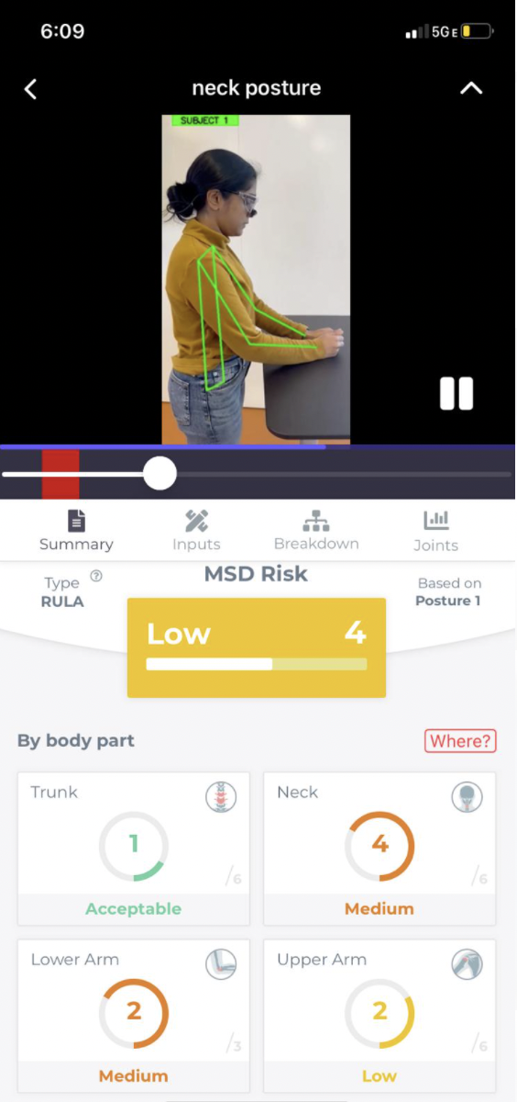
Solution Case: Neck Risk Analysis
Notes:
Walk them through how to use the product
Emphasize that this is doable → computer vision tool software

Slide 15
PATH TO MARKET
MAY-AUG ‘23
AUG- JAN ‘24
JAN- APR ‘24
APR- MAY ‘24
Software Development
IRB Approval & Trials
Strategic Partnerships
Commercial Launch
Hiring Software Developers
Partnering with Tumeke
Submit an IRB for trials on surgeon trainees
ACS
Insurance Companies
Distribution through Hospitals under recommendation from the bodies
Our Ask: $27000

Slide 16
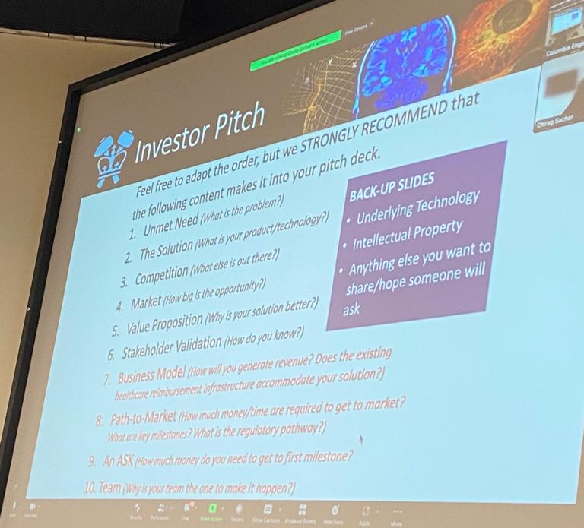
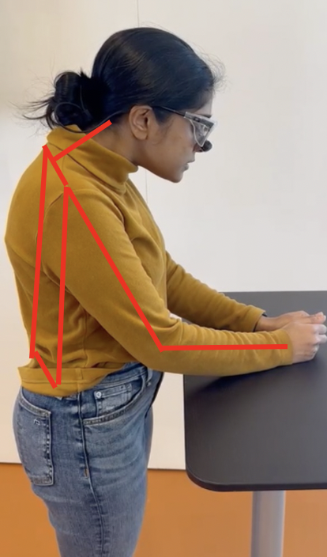
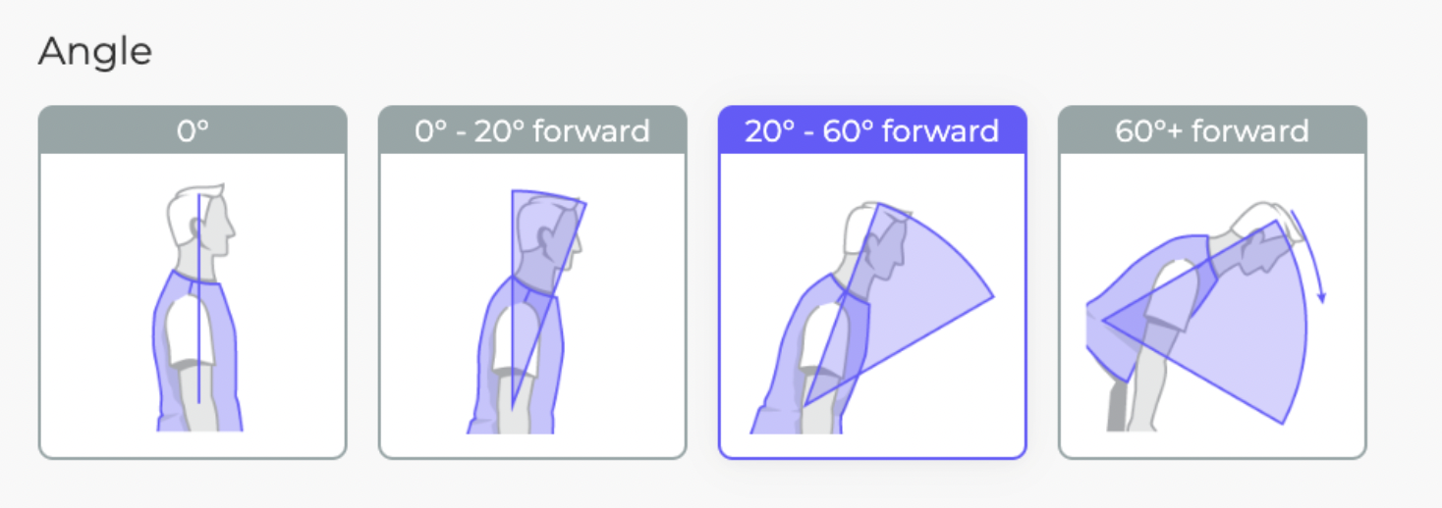
Font: Inrinia sans
High 8

Slide 17
A CV application for posture monitoring and risk assessment tailor-made for surgeons (DigiHealth InsurTech)
Why not Upright Go? -
Gap analysis - Use tumeke’s functionality and RULA assessments of upright go
Redesign cycle of care - On average, residents spend hours in sim centres to train. We leverage this environment to introduce a CV based assessment tool using RULA, and give them real-time visual feedback of their posture. Provides the hospital with performance reports to check for increase in productivity
Aim - Non-disruptive for patients and takes into account busy surgeon schedules,
Risk assessment tool for insurance companies
Solution (Jacob’s feedback) - “We tested it against 20 videos of trainees performing surgical simulation tasks and found the margin of error to be within 1-2 degrees more than 95% of the time”
Change parameters of gap analysis
Redesign path to market with monthly aims rather than yearly

Slide 18
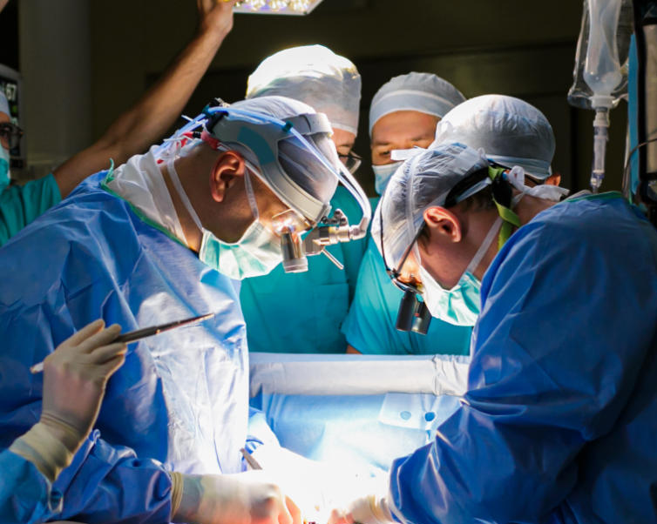
Unmet Need
Surgeons have the
Highest Rate of Work-Related Musculoskeletal Disorders
> 76.1% of surgeons report having no prior ergonomics training
A way to address lack of ergonomic surgical training for surgical residents to promote career longevity

Slide 19
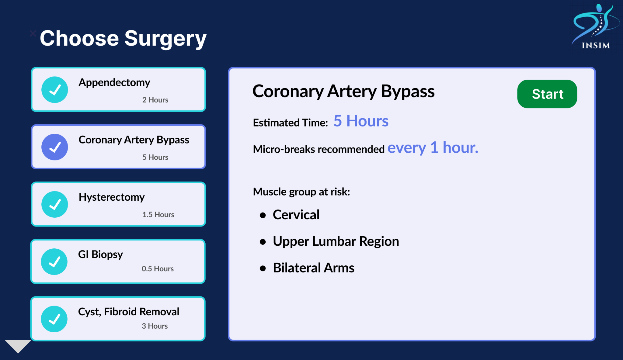
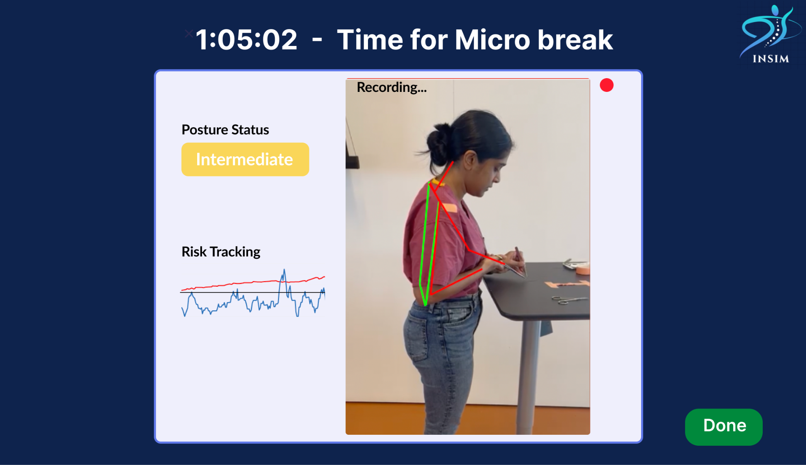
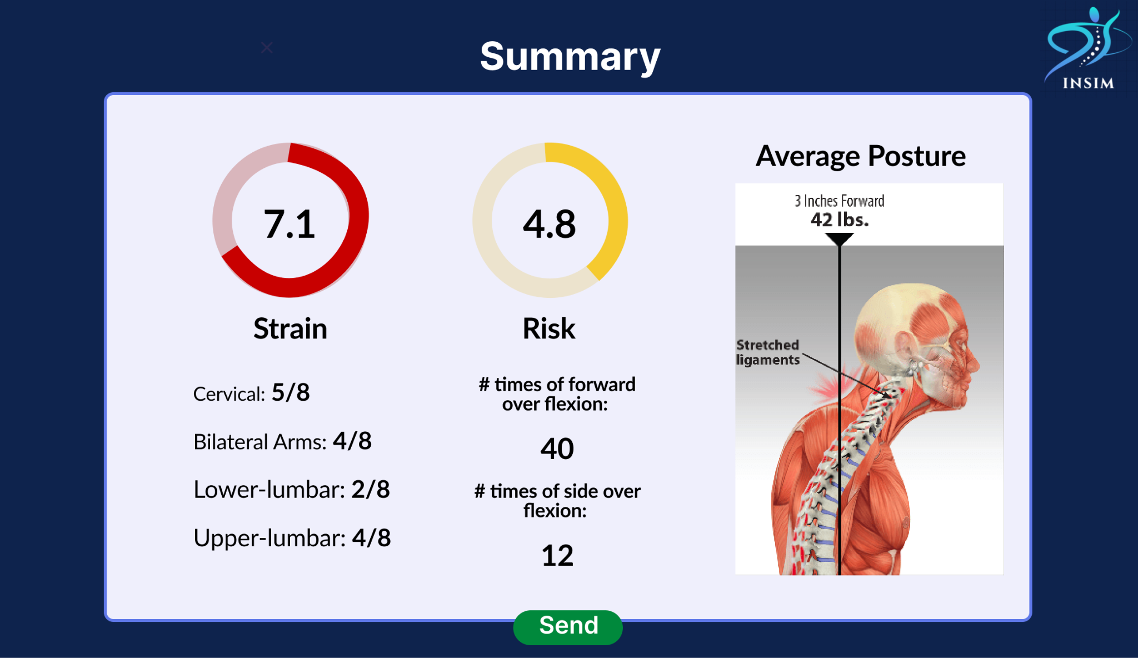
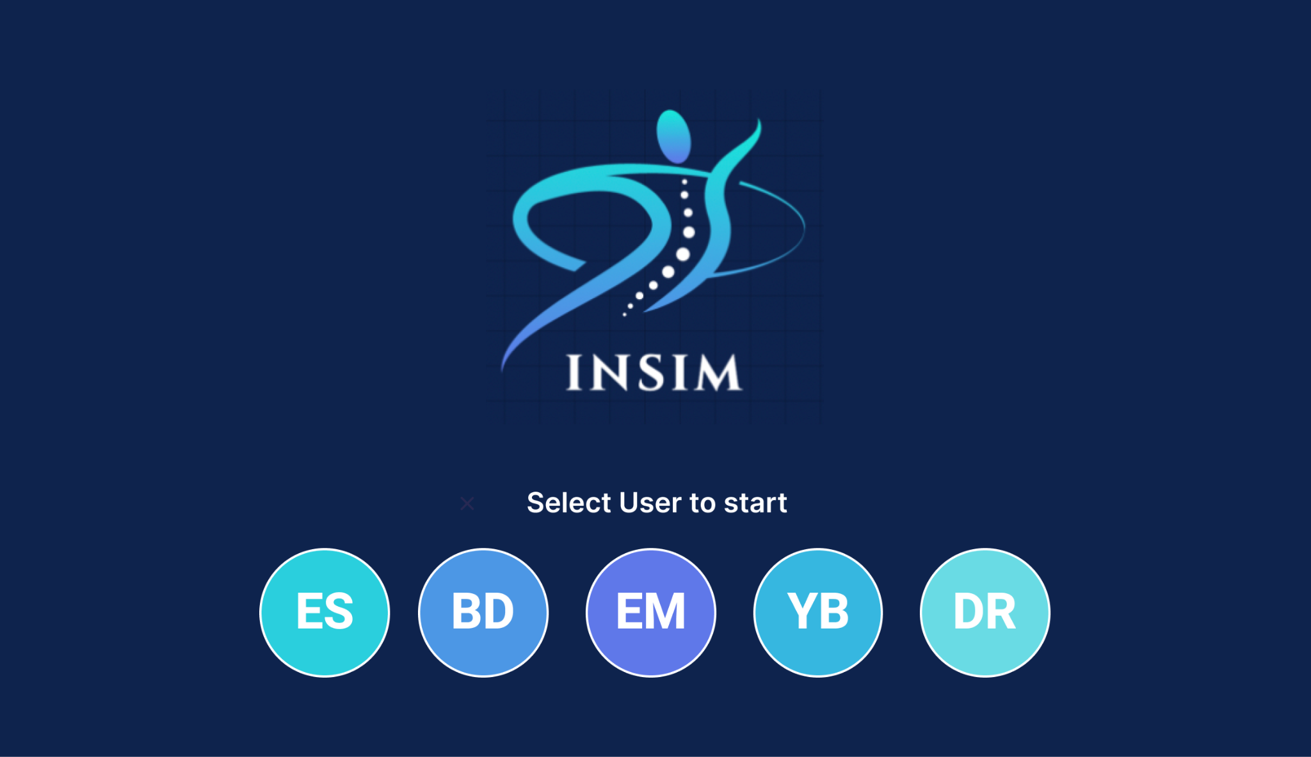

Slide 20








Our Team
Brygitte De La Cruz
Chief of Product Development
BME M.S.
BME B.E.
Engineering B.A.
Dipti Ravi
Chief of Operations
BME M.S.
BME B.E.
Elakiya Sivakumar
Chief of Outreach & Market
BME M.S.
BME B.E.
Elizabeth Maker Chief of Research
BME M.S.
Engineering Physics B.S.
Yash Bhambhani
Chief of Technology
BME M.S.
Robotics M.E
Mechatronics B.Tech.
Krista Durney
Chief Advisor
Meghal Shah
Surgeon Expert
Chirag Sachar
Chief Advisor

Slide 21

Solution
What: AI based Medical software that examines surgical posture to analyze MSD risk, give live feedback, and provide targeted strength & recovery training.
How: Tracks angles and measure RULA & REBA (Posture Risk Assessment tools) and then use uses ACS safety parameters to recommend postures during a surgical training session.
Aim: Utilize Computer Vision to train residents while they learn in the sim center in a non-disruptive and leverages the learning period. Automated RULA REBA analysis with 1 degree accuracy and visual feedback.
Notes:
Efficiency tool for the hospital + Ergonomic tool for residents
Computer vision & 3D modeling
Analogy:
Need to be trained to play sport - to prevent injury and be successful
Significant activities of surgeons
Cutting into people ← they get trained for this
standing for hours on end ← but not for this
Aim: Train surgeons to reduce ergonomic risk while performing surgery by implementing change , thereby preventing injury, increasing surgeons’ career longevity, and saving hospitals money.

